Slide 1
What’s the difference between these pairs of sentences?
Polly lived in Cardiff in 2008.
Polly has lived in Cardiff since 2008.
Bill Gates has done a lot of work for charity.
Nelson Mandela did a lot of work for charity.

Slide 2
What’s the difference between these pairs of sentences?
Polly lived in Cardiff in 2008.
Past Simple. Polly doesn’t live there anymore. The action is finished.
b. Polly has lived in Cardiff since 2008.
Present Perfect. Polly still lives in Cardiff. The action is not finished.
a. Bill Gates has done a lot of work for charity.
Present Perfect. Bill is alive and he will continue working with charities. The time is not finished.
b. Nelson Mandela did a lot of work for charity.
Past Simple. Nelson is not alive. It is not possible for him to continue working with charities. The time is finished.

Slide 3
What’s the difference between these pairs of sentences?
I visited Germany in 2010.
I have visited Germany.
I learnt to speak German in 2011.
I have learnt to speak German.

Slide 4
What’s the difference between these pairs of sentences?
I visited Germany in 2010. Past simple – definite time in the past
I have visited Germany. Present perfect – no definite time, the experience is important now e.g. looking at a map of Germany.
I learnt to speak German in 2011. Past simple – definite time in the past
I have learnt to speak German. Present perfect – no definite time, the experience is important now e.g. we are in Germany.

Slide 5
What’s the difference between these pairs of sentences?
I was in a helicopter.
I have been in a helicopter.
I climbed the highest mountain in Wales.
I have climbed the highest mountain in Wales.

Slide 6
What’s the difference between these pairs of sentences?
I was in a helicopter on my last holiday. Past simple – a completed action in the past when the time, not the experience, is more important.
I have been in a helicopter. Present perfect – a completed action in the past when the experience is more important.
I climbed the highest mountain in Wales last week. Past simple – a completed action in the past when the time, not the experience, is more important.
I have climbed the highest mountain in Wales. Present perfect – a completed action in the past when the experience is more important.

Slide 7
What’s the difference between these pairs of sentences?
I lost my wedding ring.
I have lost my wedding ring.
There was a car crash.
There has been a car crash.

Slide 8
What’s the difference between these pairs of sentences?
I lost my wedding ring. Past simple – this happened further in the past.
I have lost my wedding ring. Present perfect – this happened more recently.
There was a car crash. Past simple – this happened further in the past.
There has been a car crash. Present perfect – this happened more recently.

Slide 9
Present Perfect Tense
The present perfect tense is very common in English.
We use it to talk about:
Things that started in the past and continue until now (unfinished action or unfinished time)
Completed actions in the past but are important now
Experiences when the time is not important
Recent events
We call it present perfect because the action is important at the time of speaking.
Is there a present perfect tense in your language?

Slide 10
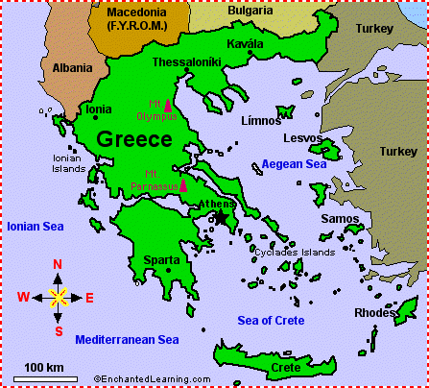
Have you ever…?
Have you ever been to Greece?
Short answers:
Yes, I have.
No, I haven’t.
Long answers:
I have been to Greece.
I have never been to Greece.

Slide 11
I have been to Greece.
What is the action?
Is the time/date of the action important?

Slide 12
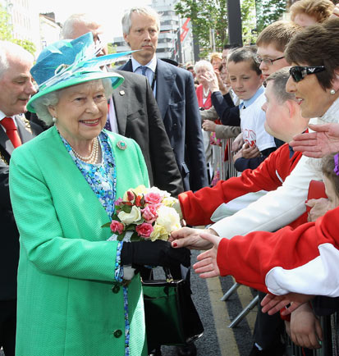
Have you ever met the Queen?
Notes:
Students answer the questions in the long form.
In groups – collate information and write a short paragraph about what the group has or hasn’t done. For example: Aida and I have been to Greece but Hashim has never been to Greece.

Slide 13
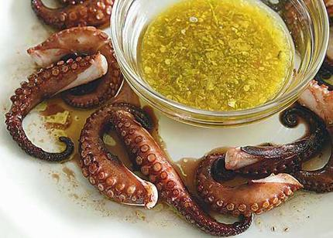
Have you ever eaten octopus?

Slide 14

Have you ever seen Harry Potter?

Slide 15
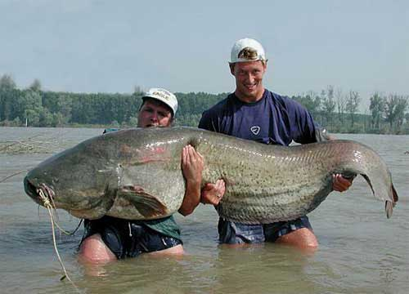
Have you ever caught a fish?

Slide 16

Have you ever failed an exam?

Slide 17
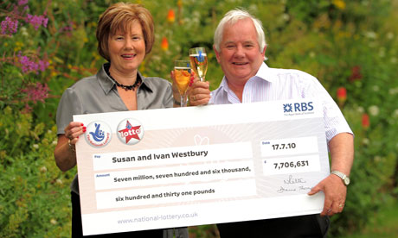
Have you ever won anything?

Slide 18


Have you ever slept all day?

Slide 19

Have you ever been skiing?

Slide 20
In groups…
Compare your answers to the questions.
Write a paragraph about what your group has or hasn’t done.
For example: Aida and I have been to Greece but Hashim has never been to Greece.

